Slide 1
GODEX
Data Exchange Meeting (New Dehli 2018)
Deutscher Wetterdienst (DWD) status report
Alexander Cress
Deutscher Wetterdienst, Frankfurter Strasse 135, 6003 Offenbach am Main, Germany
alexander.cress@dwd.de
and Robin Faulwetter, Olaf Stiller, Anne Walter, Stefanie Holbrook, Michael Bender.
Andreas Rhodin, Harald Anlauf, Christina Köpken-Watts, Kirstin Raykova, Axel Hutt etc…
GODEX Meeting Alexander Cress New Delhi 2018

Slide 2
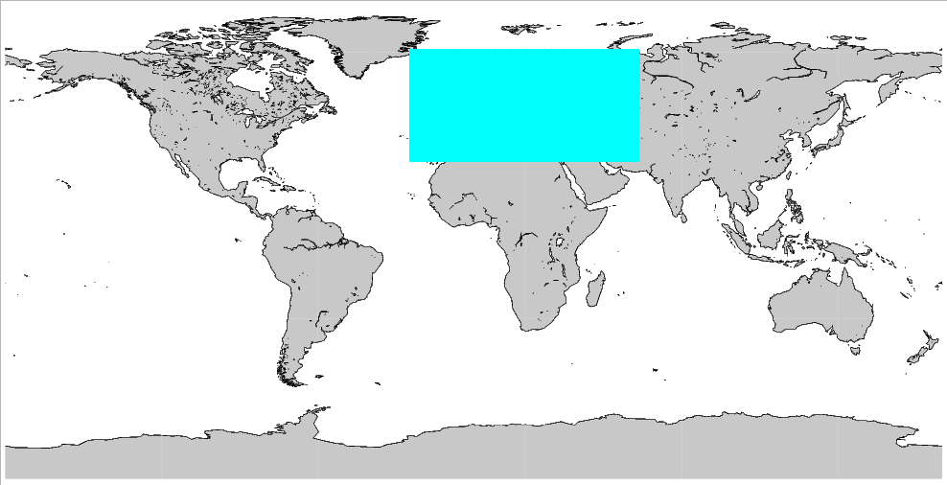
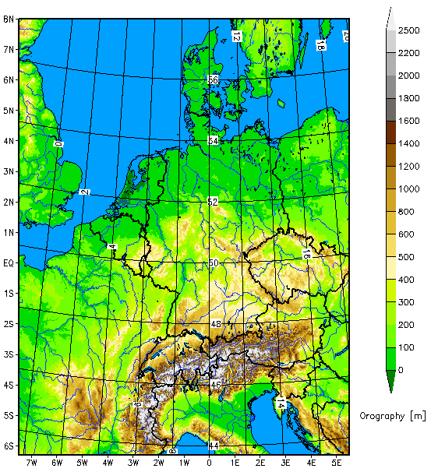
The deterministic NWP-System of DWD
Global-Modell ICON
grid size: 13 km
vertical levels: 90
Grid area: 173 km²
Hybrid DA
13km VarEnKF
Flow dependent B:
B_{VarEnKF} = αB_{LETKF} + (α-1)B_{3DVAR}
Incremental analysis update
SST, SMA and snow ana
ICON-EU Nest over Europe
grid size: 6.5 km
Vertical levels: 60
forecasts:
Grid area: 43 km²
COSMO-D2 (convection resolving)
grid size: 2.2 km
vertical levels: 60
forecasts: 3-hourly
Girid area: 8 km²
Det LETKF
GODEX Meeting Alexander Cress Lannion 2017

Slide 3
The probabilistic NWP-System of DWD
ICON-EPS; M40
grid size: 40 km
vertical levels: 90
grid area: 1638 km²
Ensemble DA
40 member 40km LETKF.
Horizontal localization radius 300km.
Relaxation to prior perturbations ( 0.75).
Adaptive inflation (0.9 - 1.5).
SST perturbations Soil moisture perturbations (experimental)
COSMO-DE-EPS; M20
grid size: 2.2 km
vertical levels: 60
Forecasts: 3-hourly
grid area: 8 km²
Ensemble DA
40 member 2.8 km LETKF
SST pertubations
Soil moisture pertubations
ICON-EU Nest over Europe
grid size: 20 km
vertical levels: 60
forecasts:
grid area: 407 km²
2nd GODEX meeting Alexander Cress New Delhi 2018

Slide 4
Satellite data usage
Microwave and infrared instruments
Obs.System | Satellite | Channels | Remarks
AMSU/A | NOAA 15/18/ 19 METOP-A/B | 5-14 | RTTOV10 over sea and high peaking channels above clouds and land
MHS | NOAA 19 METOP-A/B | 3-5 | Only overland and sea
ATMS | NPP NOAA 20 in prep. | 6-15 | Over sea and high peaking channels above clouds and land
SSIM/S | F-16, F-17, F18 | 4 channels | Monitoring, first experimets
AMSR-2 | GCOM-W1 | 4 channels | Monitoring, first experimets
GMI | GPM | 4 channels | Monitoring, first experiments
SAPHIR | Megha-Tropiques |  | Monitoring, first experiments
IASI | METOP-A/B | ~62 infrared channels 16 WV sensitive | over sea and high peaking channels above clouds and land
Cris | NPP NOAA 20 in prep. | ~50 channels | Monitoring and first assimilation experi.
MWTS-2/MWHS-2 | FY-3C |  | Monitoring and first experiments

Slide 5
Satellite data usage
Microwave and infrared instruments
Obs.System | Satellite | Channels | Remarks
Radioccultation | Cosmic, Gras, TerraSar, Tandem-X, FY-3C | Upper troposphere and stratosphere | Observation operator; own development
AMV | Meteosat 8/11, Himawari-8, GOES 15/16 MODIS, NOAA series and Metop, NPP/VIIRS, Insat-3,FY-2G, COMs | Infrared, visible and wv | Over sea and partly over land. Qi threshold
Scatterometer | ASCAT on Metop-A/B ScatSat |  | Sea only
Altimetry | Jason-2, Jason-3, Saral | Wind speed | Over sea used since beginning of 2017
Geostationary radiances | Meteosat 8/11 Seviri Himawari 8 in prep. | Clear sky All-sky WV channels VIS/Near-infrared | operational First experiments in regional model

Slide 6
New developments since last meeting
AMSU-A/ATMS reduced thinning and retuning of obs error
Use of MHS humidity channels over land
Introduction of inter-channel correlations
Meteosat 8/11 CSR operational
Microwave imager radiances > First experiments
New member of NWP SAF
Meteosat 11 and GOES 16 AMVs operational
Global Metop A/B operational
Radiooccultation data from FY-3C operational
Radiosondes in Bufr format (including drifting) operational
Use of MODE-S aircraft data in regional model operational
Monitoring of Vaisala RS 41 descenting data
Pre-operational use of GNSS data (ZTD) in global model
Experiments using STD GNSS data in local model
Use OSTIA SST and sea ice analysis operational
2nd GODEX meeting Alexander Cress New Delhi 2018

Slide 7
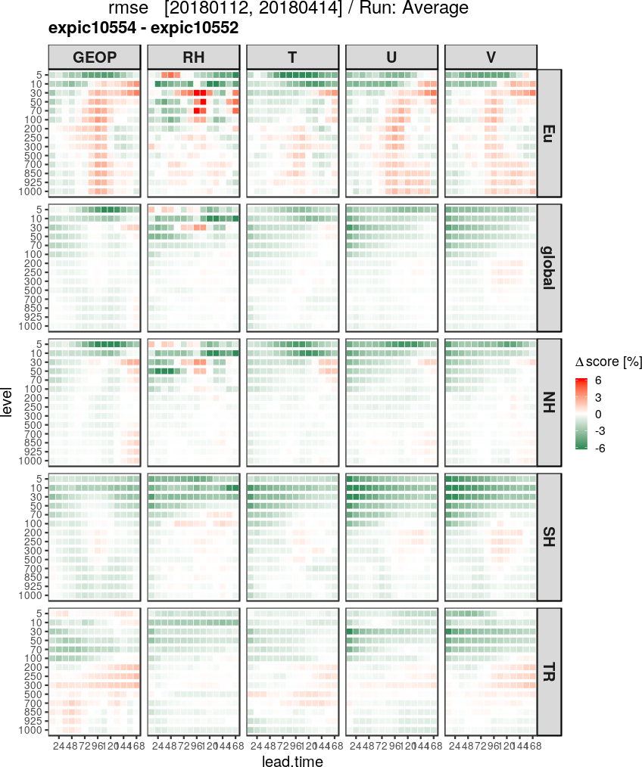
Less thinning and tuning of
obserrors (T channels)
Thinning for T channels (IASI, AMSU-A and ATMS): 240km to 160km
less information is lost
smoother analysis increments
Larger impact of T channels
Impact is positive only in combination with tuning of obserrors (Desroziers method)
With 1) and 2) the weight of the T channels in the analyses is approx. unchanged

Slide 8
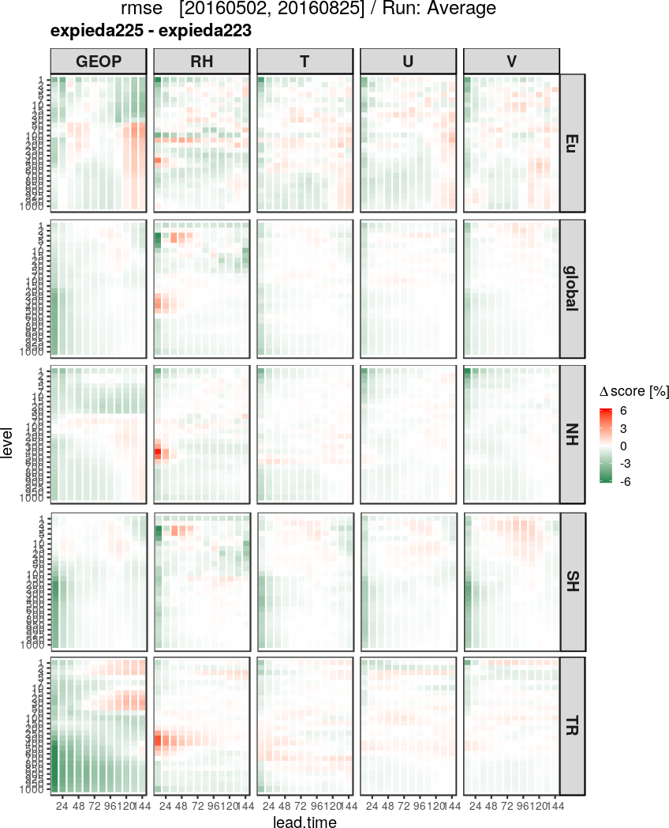
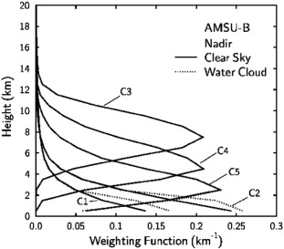
MHS assimilation above land
3 atmospheric channels (3,4,5), the high peaking channels (3,4) are used above land

Slide 9
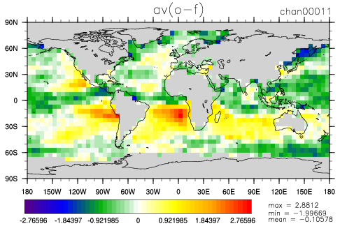
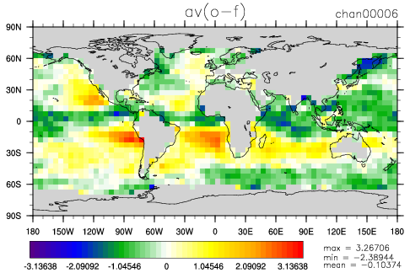
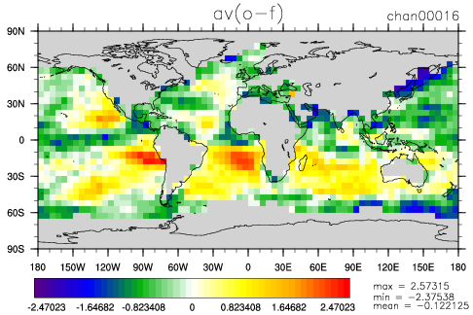
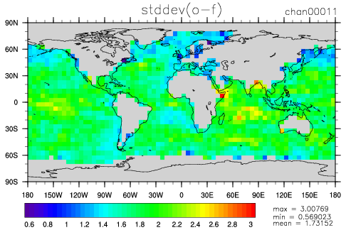
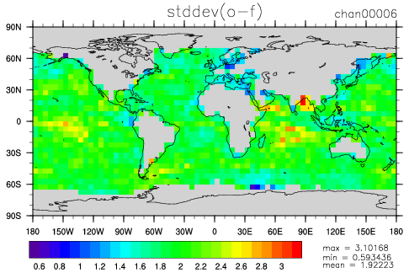
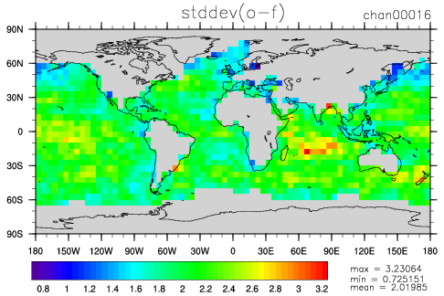
Assimilation of microwave imagers
AMSR2 on GCOM
36.5 GHz V
GMI on GMP
36.5 GHz V
SSMI/S on DMSP-F17
37.0 GHz V
mean (obs – fg)
stddev (obs – fg)
Preparation for assimilating microwave imagers (19 GHz, 24 GHz, 37 GHz, 89 GHz)
in clear sky situations over sea
bias correction and sea ice detection (strong dependence on surface emissivity)
exclusion of scattering situations (cloud detection)
First assimilation experiments started

Slide 10
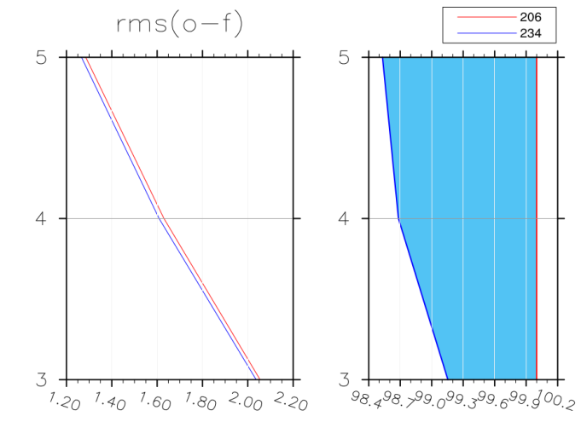
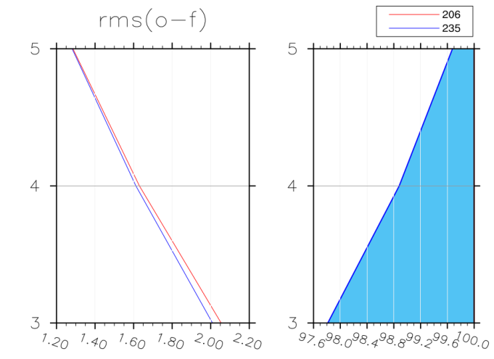
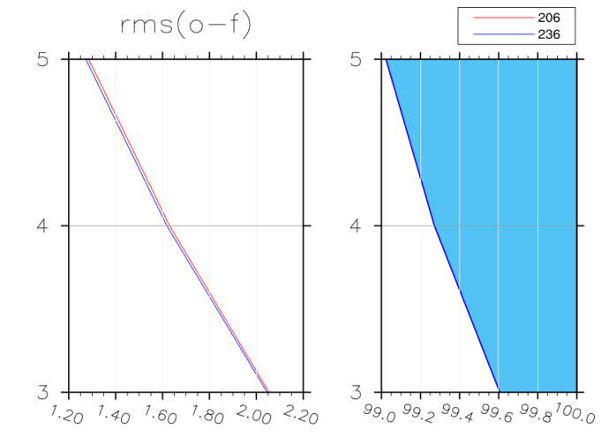
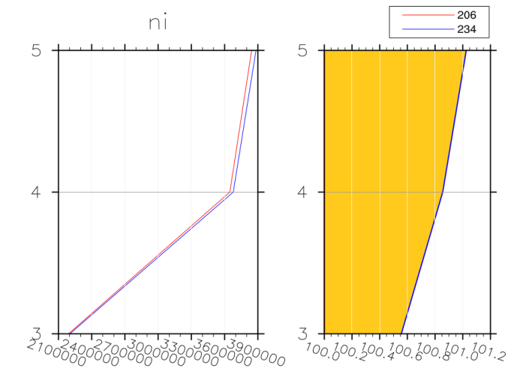
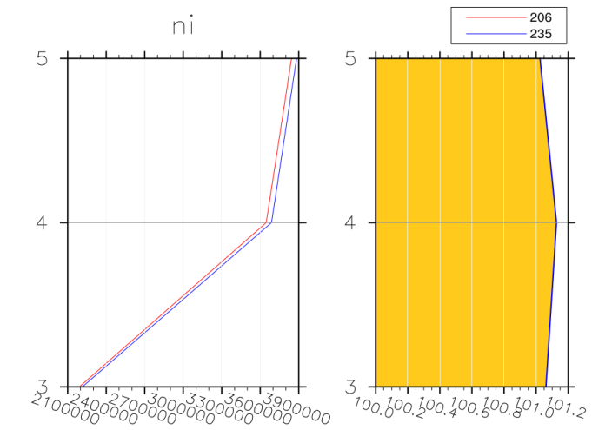
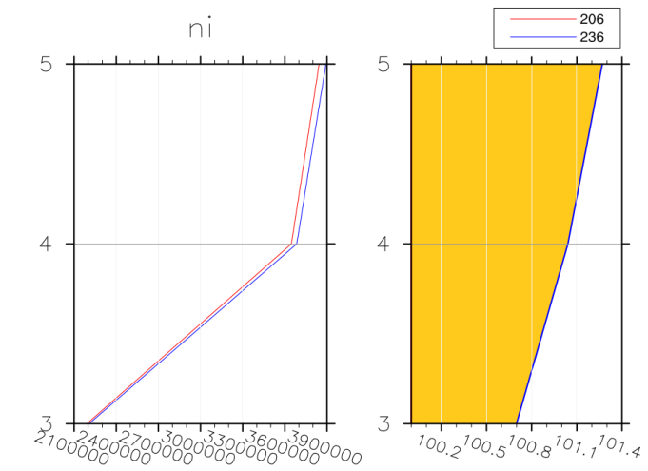
Assimilation of further humidity sounders
Statistics for MHS
GMI
SAPHIR
MWHS2

Slide 11
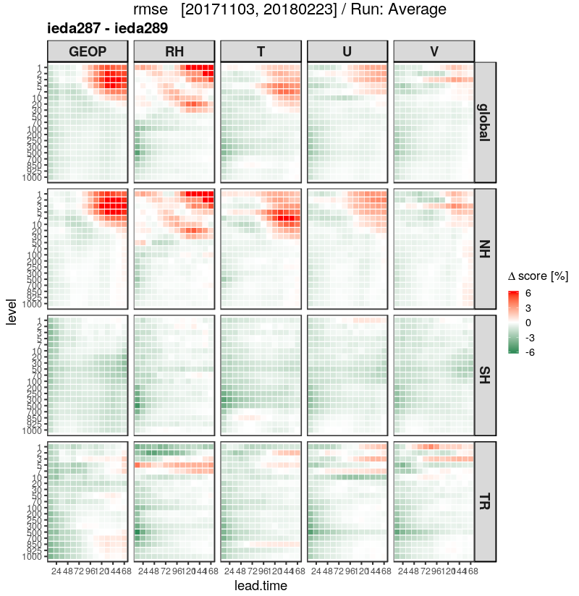
Interchannels correlations
IASI interchannels correlations
Interchannel correlations derived with Desroziers method and smallest eigenvalues are put to a threshold
First step: hyperspectral sounders (IASI currently)
Second step: MW humidity sounders
Third step: Cris

Slide 12
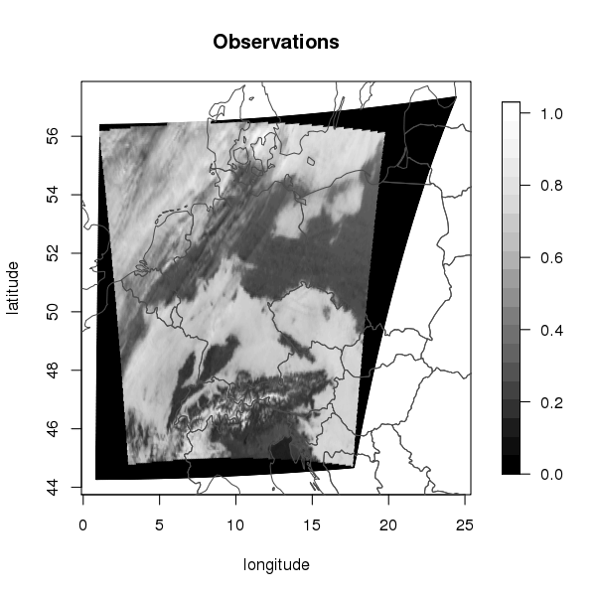
NWP SAF – DWD cooperation Observation operator MFASIS
MFASIS (Method for FAst Satellite Image Simulation (Scheck 2016))
Fast and accurate observation operator for simulating satellite images in the visible spectral range (0.6 micron, 0.8 micron), e.g. SEVIRI-VIS
Assimilation of reflections possible
No multiple scattering, shadow effects included
DWD has integrated MFASIS to RTTOV in the framework of NWP-SAF
Model variables
Look Up Table
artifcial satellite picture
temperature
pressure
specific humidity
cloud water
cloud ice
snow
cloud cover
scattering angel
Integrated optical depth
effitive partikel radius
Albedo
Sun zenit angle
Satellite zenit angle
scattering angle
Künstliches
Satellitenbild
computation
dimensions

Slide 13
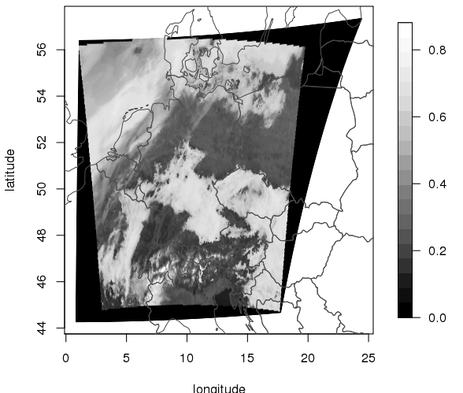
NWP SAF – DWD cooperation
Satellite monitoring
Observation
Model equivalent
First monitoring and assimilation experiments have been run using the COSMO-DE-KENDA system
Positive impact on cloud cover, moisture bias, precipitation, surface variables
Jacobian allows for assimilation in ENVAR which is planned for the global and convective scale as well

Slide 14
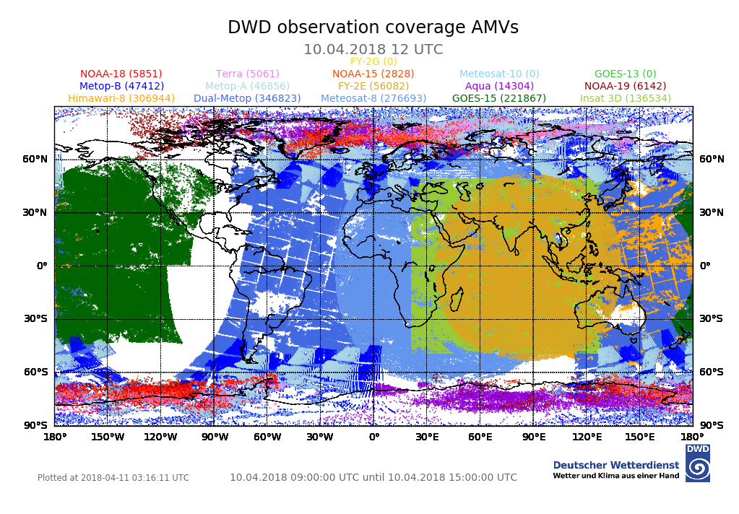
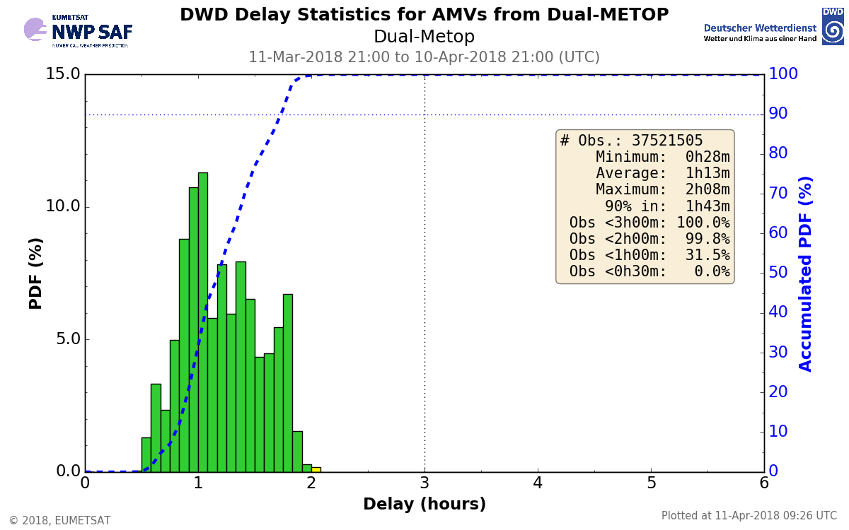
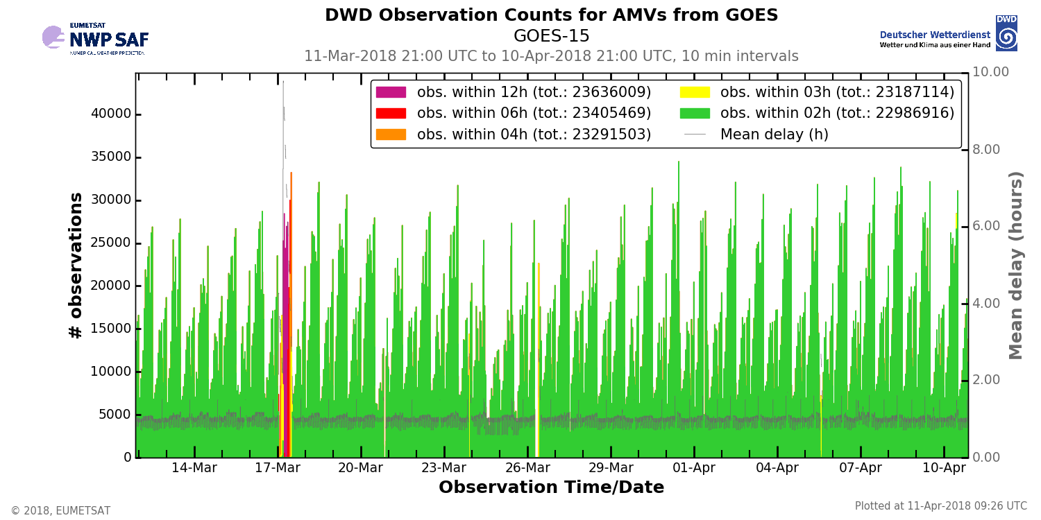
NWP SAF – DWD cooperation
Satellite monitoring
www.nwpsaf.eu

Slide 15
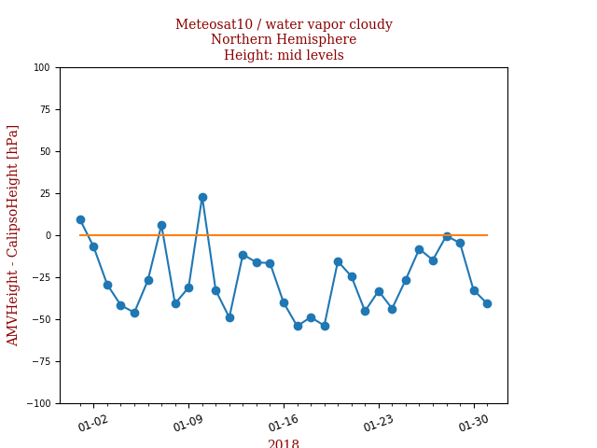
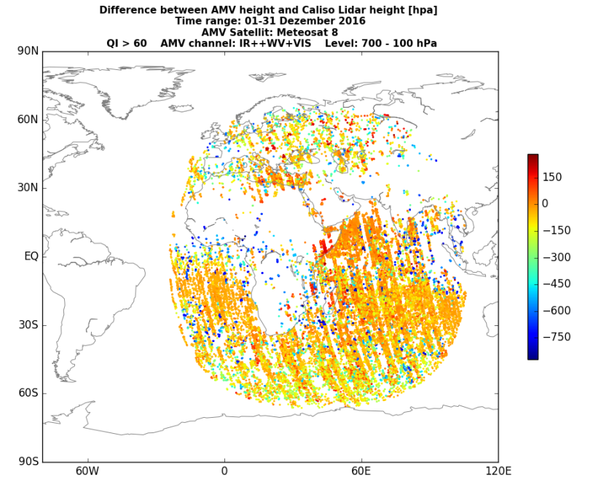
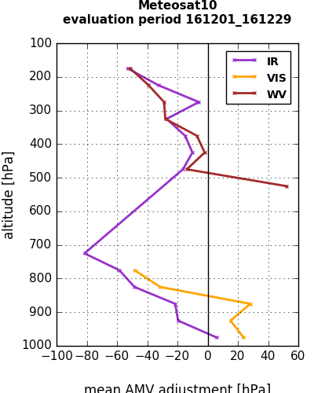
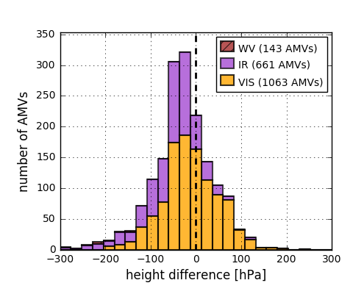
NWP SAF – DWD cooperation
AMV-Calipso lidar height monitoring

Slide 16
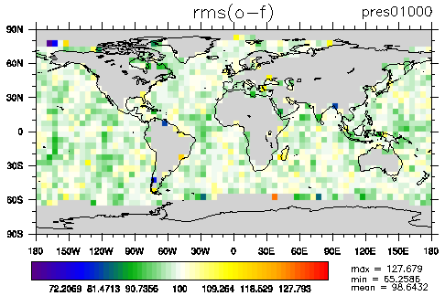
Use of scatterometer data
Operationel use of ASCAT onboard Metop 3/4
Pre-operationel use of ScatSat
Operational use of Altimeter data (Janson 2/3, SARAL)
Wind speed bias correction of Scatterometer/Altimeter data
Relative difference of obs – fg rms between exp. with and
without ScatSAT data for ASCAT observations
mean: 98.64 %

Slide 17
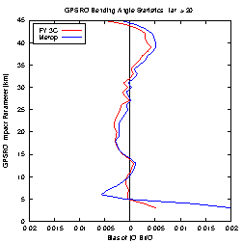
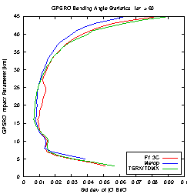
Use of GPSRO FY-3C
extra tropics
Operational satellite of the Feng-Yun-3 series since 2013
Polar-orbiting: RO-Instrument: GNOS
Design similar to GRAS instrument onboard Metop
Able to use multiple GNSS signals (GPS, Beidou)
GPSRO available in NRT on GTS (ca. 400/d) since July 2017
BDSRO not available
Data quality is acceptable since November 2017
Operational use since summer 2018
bias
Polar region
stdev

Slide 18
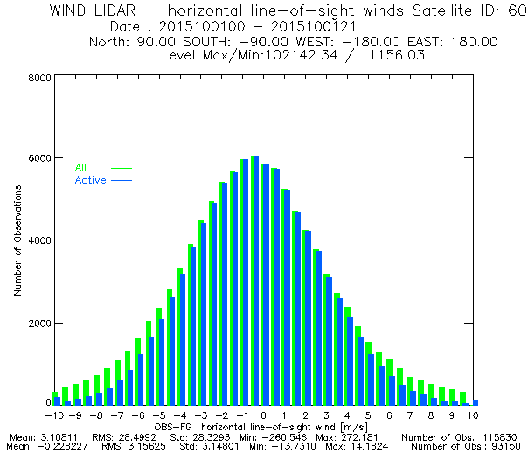
Aeolus Wind Lidar work
Aeolus will be launched in 2018
Observation will be HLOS
Level 2B Cal/Val rehearsal dataset provided
by ECMWF
The data has been regenerated (in March 2018)
with the most recent processing chain:
E2S v4.01, L1B v7.01 and L2B v3.00.
Data are provided in Bufr Format
Bufr reading is finished
Observation operator implemented
One day data assimilation with test data conducted
Looking forward on the real data

Slide 19
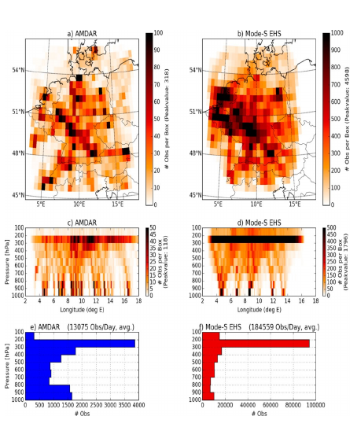
Mode-S EHS aircraft
Mode-S aircraft
derived from radar data from air-traffic control,
processed + provided by KNMI
wind vector + temperature,
T derived from Mach number
every 4 sec
compared to AMDAR:
>10 x more data
no humidity, larger T error
from: Lange and Janjic, MWR 2016

Slide 20
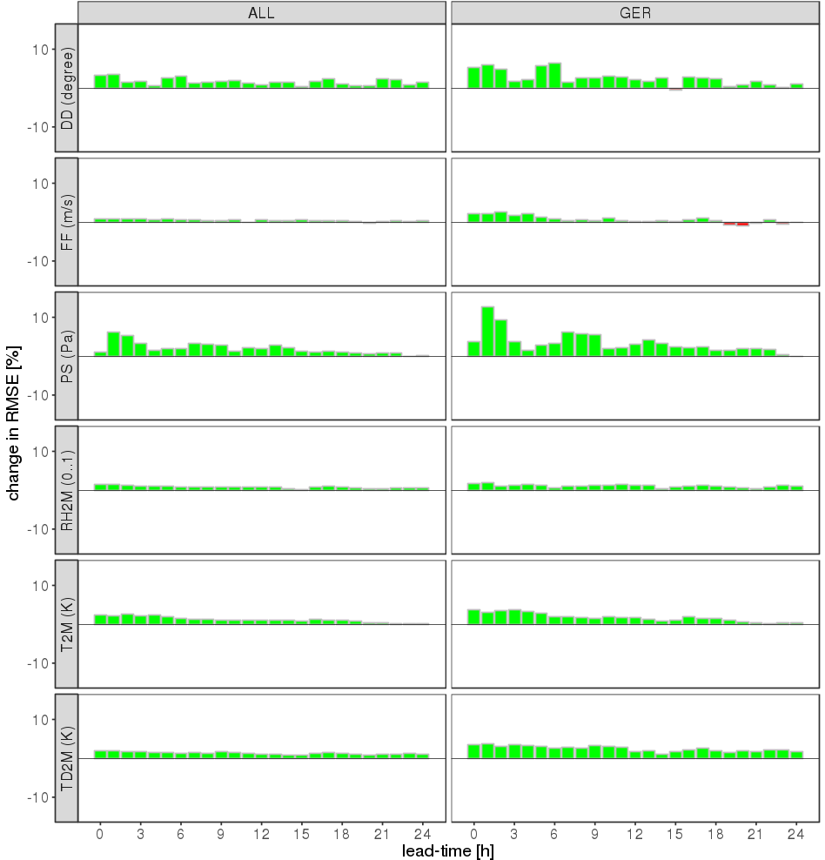
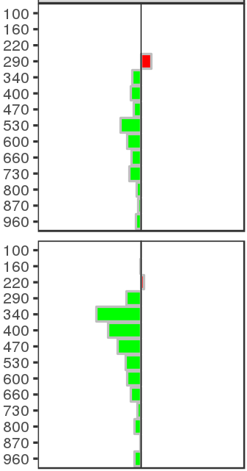
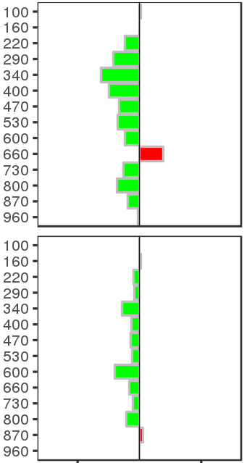
Mode-S EHS aircraft convective period
Mode-S aircraft : forecast verification
(26 May – 10 June 2016)
wind dir.
RH
wind
dir.
wind speed
ps
T
wind
speed
RH2M
T2M
TD2M
change in RMSE [%]
positive impact from Mode-S throughout

Slide 21
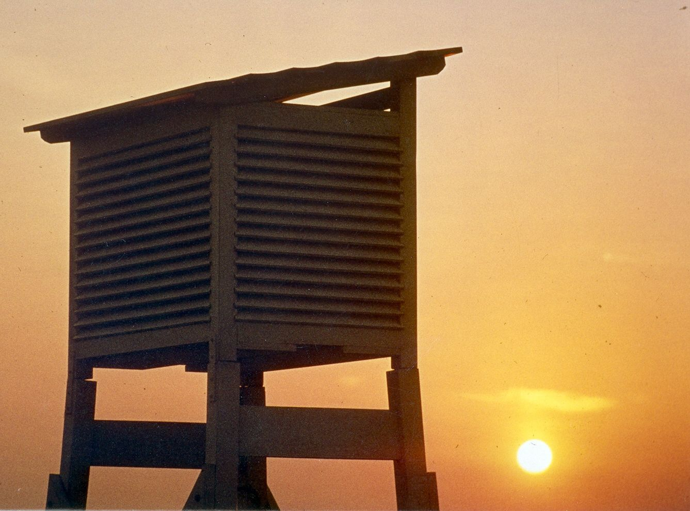
Thank you for your attention! Questions?

